Slide 1

Atlanta Food Consortium
CS 6150 Computing for Good
Final Presentation
Richard Young Jr
Kierstin Ajaden Hicks
Dipen Patel
William Hui Hao
Srijan Srivatsa
Wesley Baker

Slide 2
Background
The Problem
  1 in 9 people in Metro Atlanta face food insecurity
  125,000 tons of food are wasted each year
The Gap
  Disconnected systems between food donors and nonprofits
  Limited visibility into supply and demand
The Opportunity
  Better coordination can reduce waste and improve access
  Technology can connect surplus food to those in need
Our Context
  The Metro Atlanta Food Consortium works to streamline food distribution across organizations in Metro Atlanta

Slide 3

Project Chronology
Formation
Delivery
Planning
Evaluation
Development
Notes:
The project followed five stages. In the formation and planning stages, we completed team formation and defining goals, followed by creating the project webpage. During development, we presented early work in mini presentation and refined it through initial evaluation. In the evaluation stage, we demonstrated our system in the demo and gathered feedback in the field evaluation. Finally, in the delivery stage, we are completing the final presentation, developer documentation, and final report.

Slide 4
Course Principles
Human Centered Design: Built for diverse stakeholders with a focus on usability and real needs
Iterative Development: Improved the platform through continuous feedback and refinement
Simple & Flexible: Created intuitive workflows that adapt to different organizations
Data-Driven Impact: Dashboard enables visibility into food distribution and system performance
Sociotechnical Focus: Uses technology to address food insecurity at scale

Slide 5
Screenshots

Slide 6
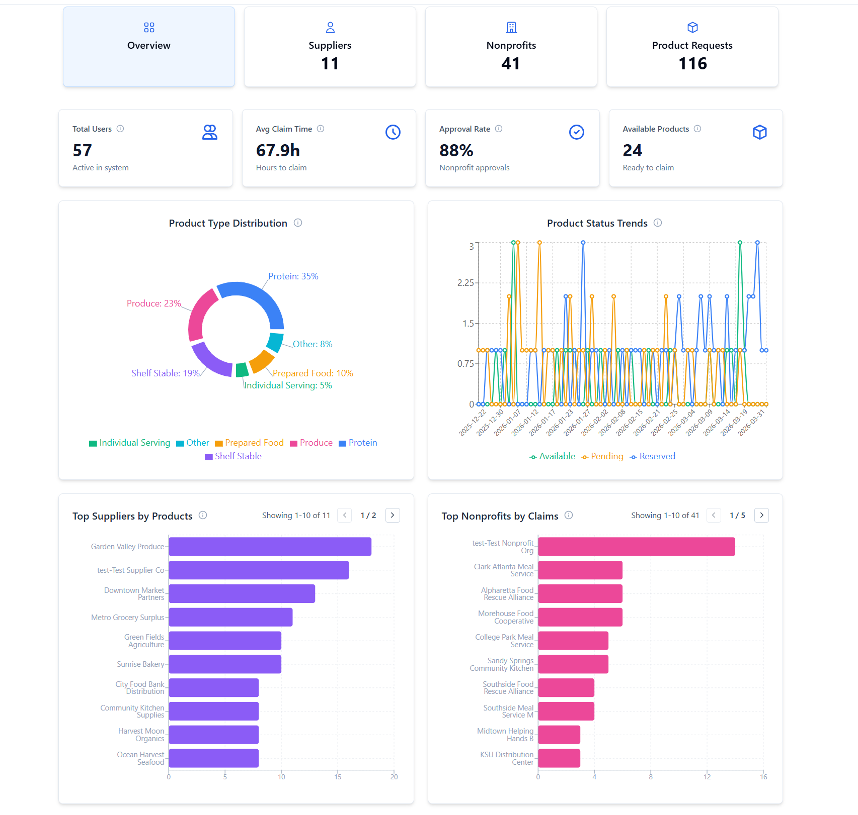

Admin Dashboard
Administrators monitor the platform's impact at a glance. They can track active suppliers, registered nonprofits, total food listings, and completed claims. Visual charts show trends over time, helping the consortium measure its effectiveness and identify where to focus outreach efforts.

Slide 7
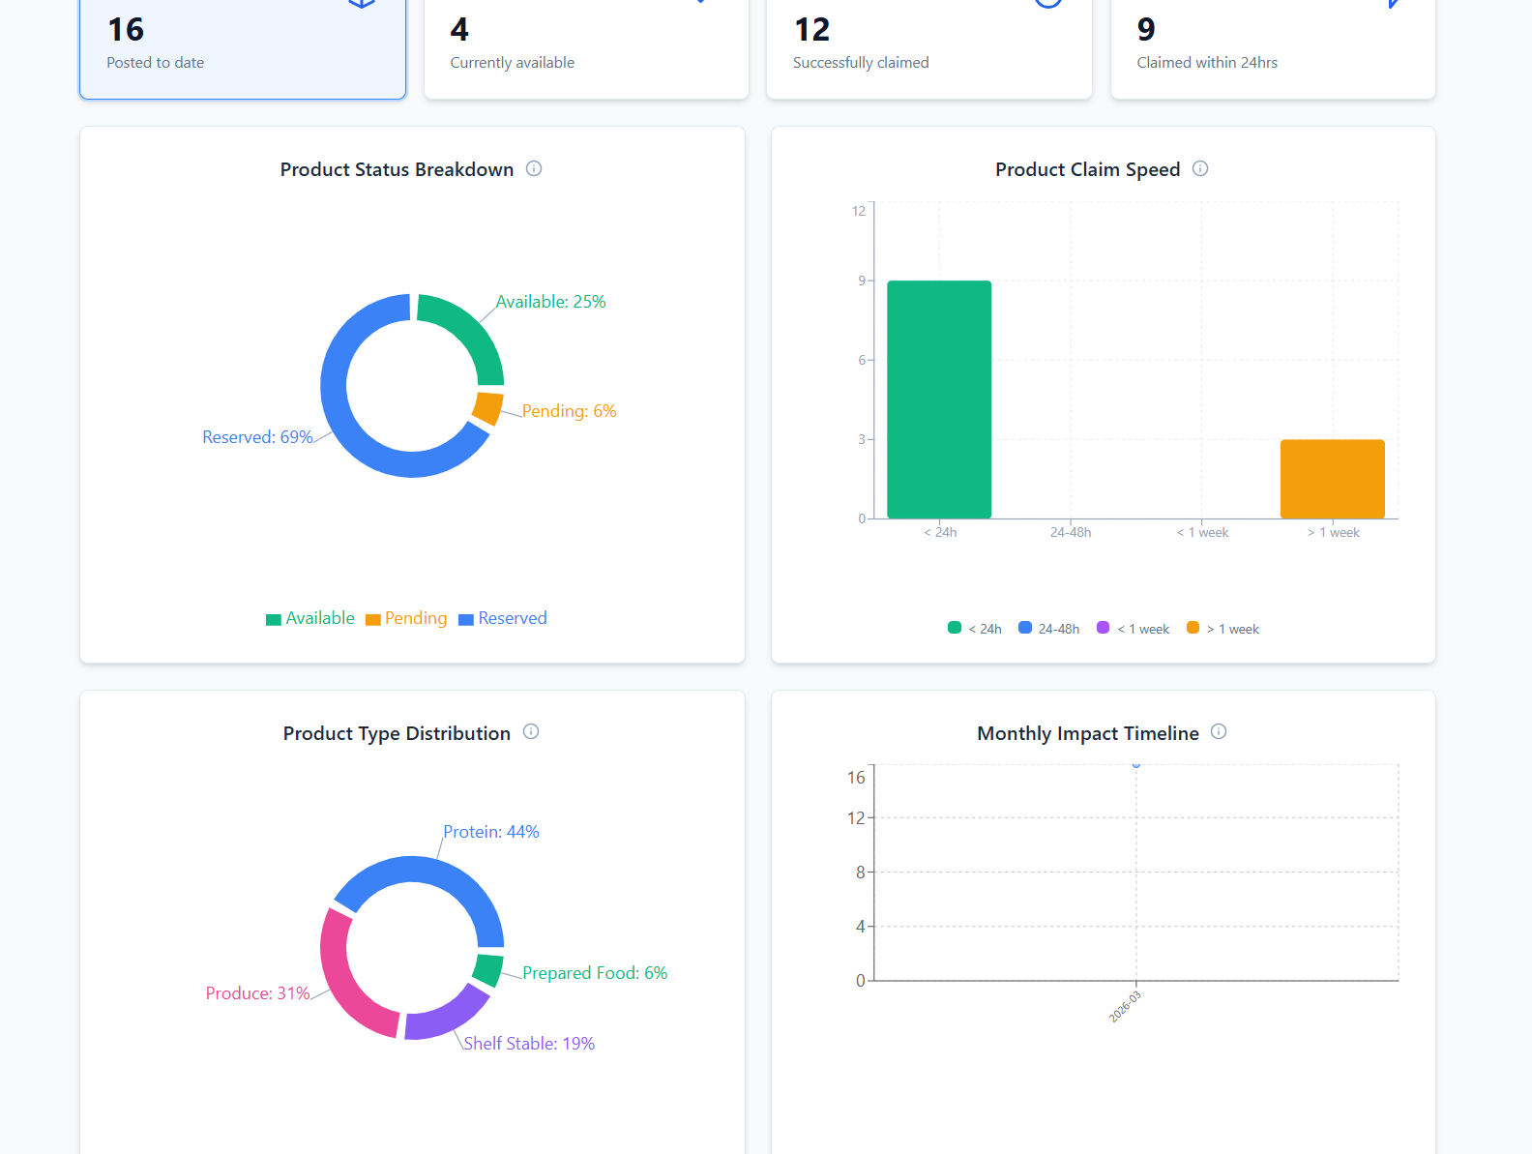
Supplier Dashboard
Suppliers such as grocery stores, restaurants, and distributors can list their surplus food items by specifying the product name, type, quantity, and any additional details. They can easily edit, remove, or repost listings, turning potential food waste into available donations for nonprofits

Slide 8
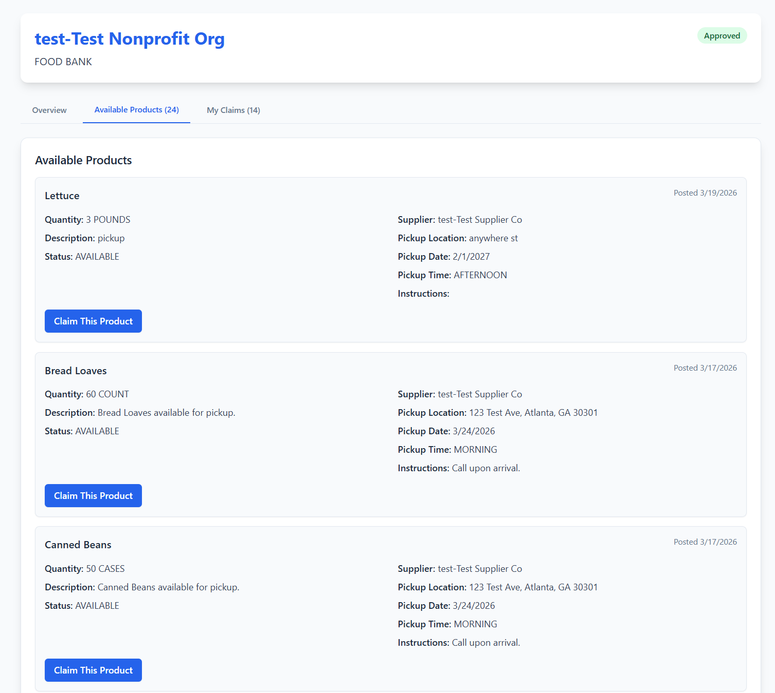
Nonprofit Dashboard
Nonprofits can browse all available food donations in one place and claim items that match their needs and storage capacity. Once claimed, they coordinate pickup details including date, time window, location, and a contact person to ensure a smooth handoff.

Slide 9
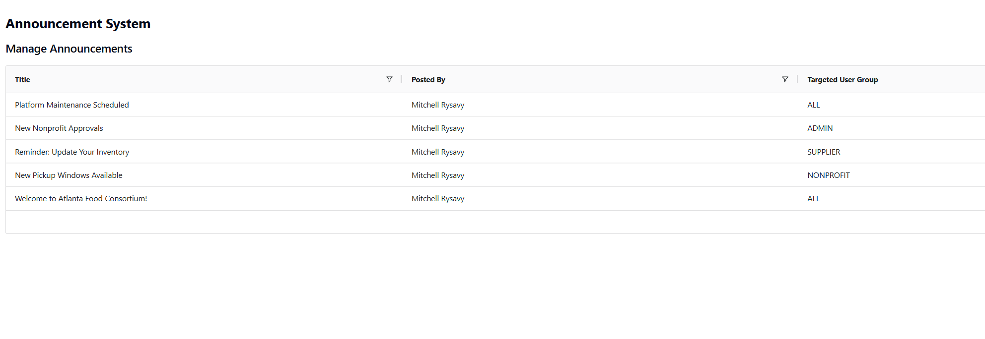
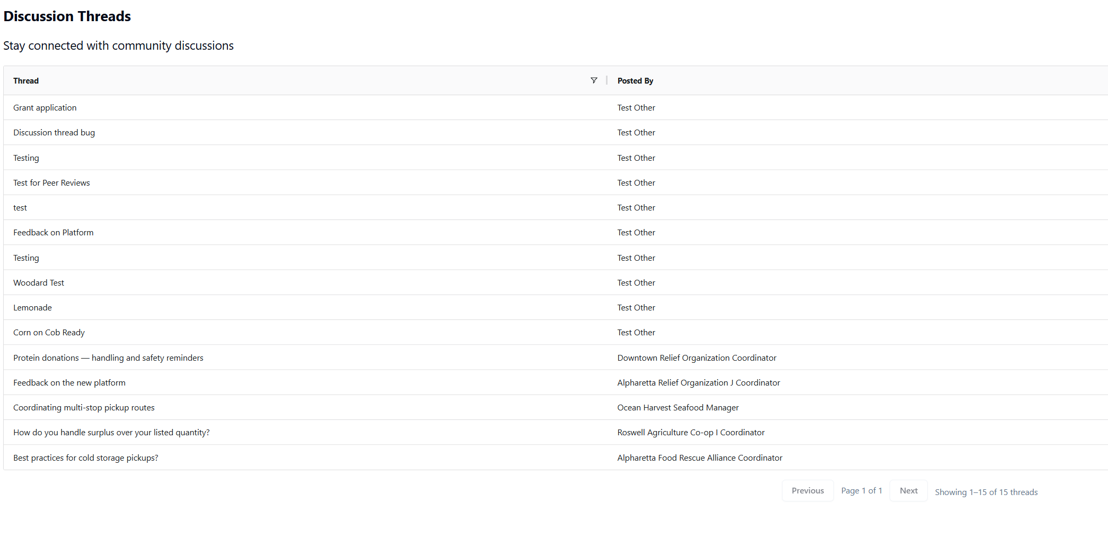
Discussions & Announcements
The platform includes built-in announcements and discussion boards to keep the community connected. Admins can broadcast updates to all users or target specific roles, while suppliers and nonprofits can start conversations and coordinate directly through threaded discussions.

Slide 10
Removal of Sensitive Data
3 environments (Production, Staging, Development)
No personal information in lower environments
Information stored in secured production environments
Changes are reviewed before changing environments

Slide 11
User Documentation
Included in the final submission:
Comprehensive guides for all user roles: suppliers, nonprofits, and admins
Step by step onboarding and workflows for key actions like posting, claiming, and approvals
Clear explanations of system features, statuses, and processes
Includes FAQs and troubleshooting for common issues
Designed so new users can navigate and use the platform independently

Slide 12
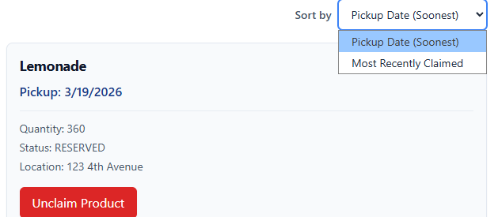
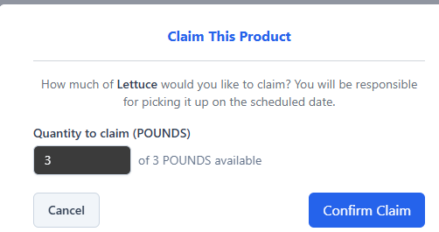

Feedback and Improvement
Examples of User Feedback
Addressing the Implementation Requests
Difficulty finding navigation menus and user options
Recently claimed products were hard to see
Claims were limited to all-or-nothing
Wanted dashboard stats (e.g., total products) to be interactive
Redesigned navbar into a tabular layout for easier navigation
Added sorting for claims (earliest pickup date, most recently claimed)
Implemented partial product claiming
Made dashboard KPI tiles clickable for easier access to product details

Slide 13
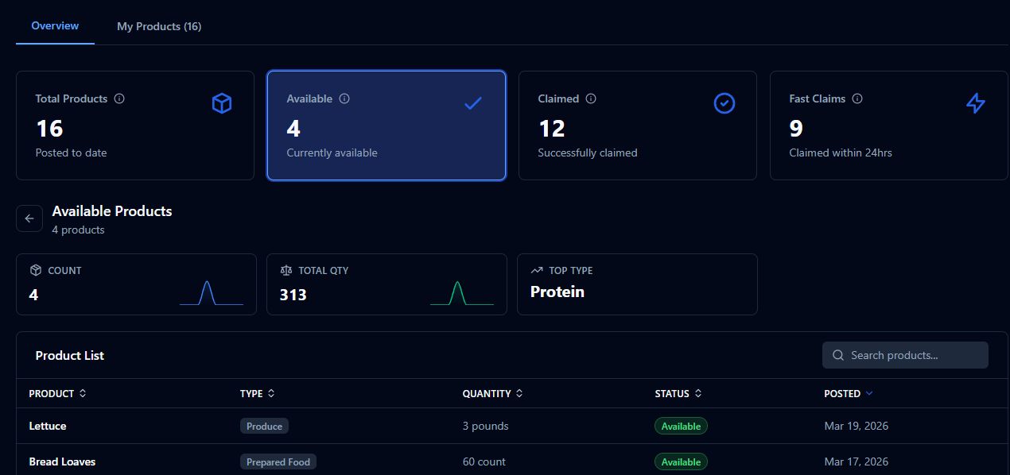
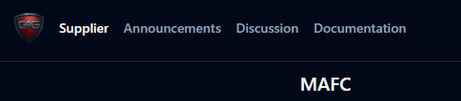
More Visual Evidence of Feedback Improvements

